Slide 1
Social Network Analysis
Epidemics

Slide 2
Epidemics
Contagious diseases caused by biological pathogens
Epidemics can be of different kinds
Sudden explosion
Persist for a long time at low levels
Sudden flare-ups
Cyclic patterns
Can be devastating
Bubonic plague that killed 20% of Europe in a 7 year period in 1300s
COVID 19

Slide 3
Networks Influence on Epidemics
Epidemics determined by
Pathogens: Contagiousness, Length of infection
Social Network
Pathogens determine Social Network
Air-borne: Lot of links in the network
Close contact: Sparse network
Similar for computer viruses

Slide 4
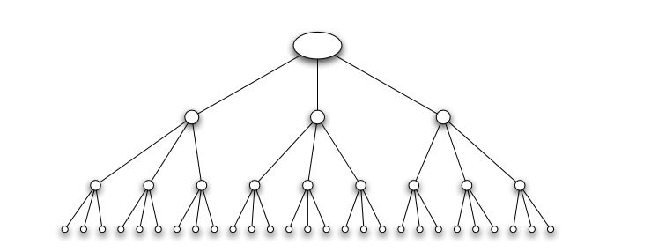
Branching Process
Suppose that a person carrying a new disease enters a population, and transmits it to each person he meets independently with a probability of q (or p) (Contagion probability). Further, suppose that he meets d (or k) people while he is contagious.

Slide 5
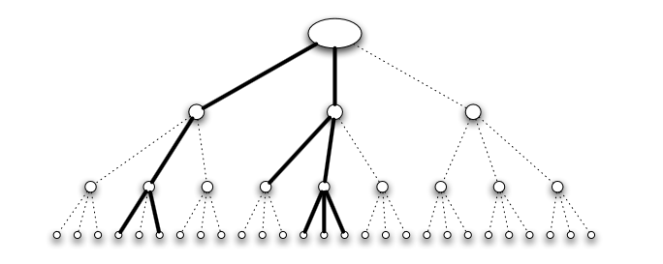
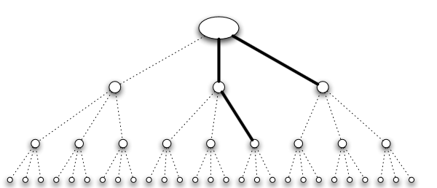
Effect of Contagion Probability
High q: Disease spreads
Low q: Disease dies out

Slide 6
Reproductive Number
R₀ = q.d
If R₀ < 1 then with probability 1 the disease dies out after a finite number of waves
If R₀ > 1 then with probability, then with probability greater than 0 the disease persists by infecting at least one person in each wave
If R₀ is near 1 a small change in k or p can have a significant change in the effect of the disease
Reducing R₀
q: Encouraging better sanitary practices reduces germs spreading
d: Quarantining people

Slide 7
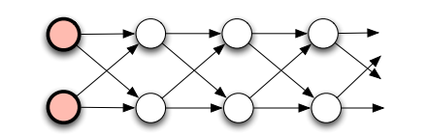
Reproductive Number – Relevant only for Tress
R₀ = 2/3 * 2 = 4/3
However the disease will die out after reaching only a finite number of steps.
In each layer, there are four edges leading to the next layer, and each will independently fail to transmit the disease with probability 1/3. Therefore, with probability (1/3)⁴ = 1/81, all four edges will fail to transmit the disease — and at this point, these four edges become a “roadblock” guaranteeing the disease can never reach the portion of the network beyond them.
Thus, as the disease moves along layer-by-layer, there is a probability of at least 1/81 that each layer will be its last.
Therefore, with probability 1, it must come to an end after a finite number of layers.
In this network, the epidemic is forced to pass through a narrow “channel” of nodes. In such a structure, even a highly contagious disease will tend to die out relatively quickly

Slide 8
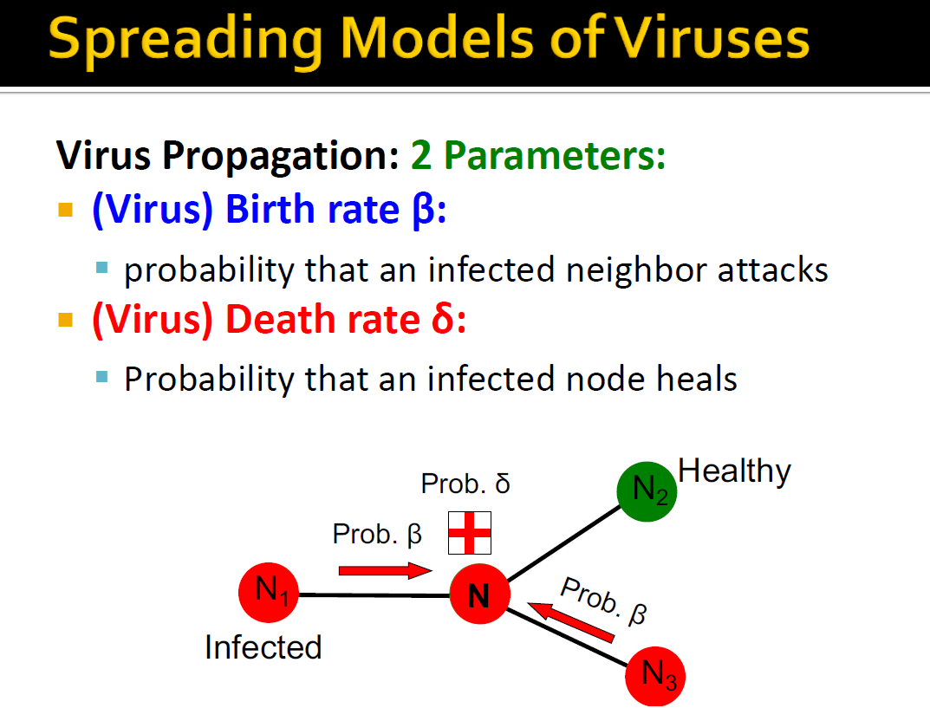

Slide 9
SIR Epidemic Model
An individual node in the branching process model goes through three potential stages during the course of the epidemic:
Susceptible: Before the node has caught the disease, it is susceptible to infection from its neighbors.
Infectious: Once the node has caught the disease, it is infectious and has some probability of infecting each of its susceptible neighbors.
Removed: After a particular node has experienced the full infectious period, this node is removed from consideration, since it no longer poses a threat of future infection
The progress of the epidemic is controlled by the contact network structure and by two additional quantities:
p (the probability of contagion)
t_{I} (the length of the infection).
Initially, some nodes are in the I state and all others are in the S state.
Each node v that enters the state remains infectious for a fixed number of steps t_{I}
During each of these t_{I} steps, v has a probability p of passing the disease to each of its susceptible neighbors.
After t_{I} steps, node v is no longer infectious or susceptible to further bouts of the disease; we describe it as Removed (R)

Slide 10
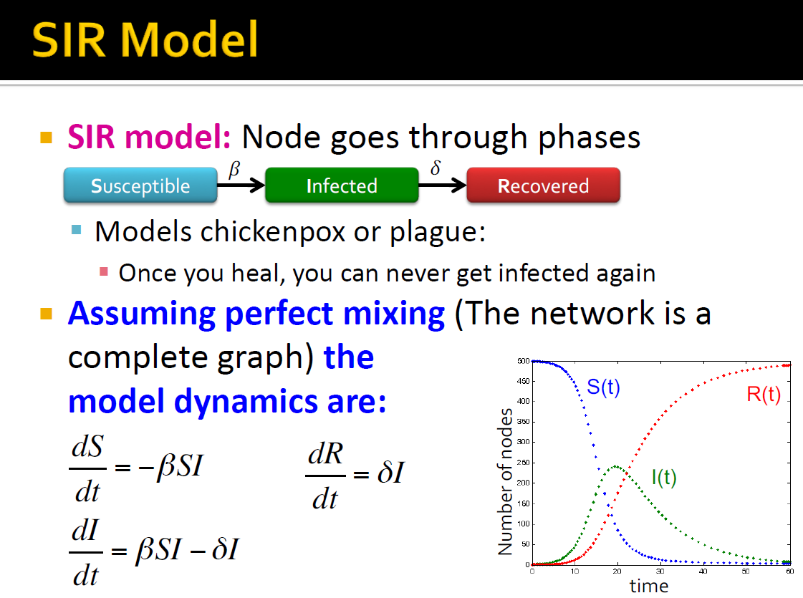

Slide 11
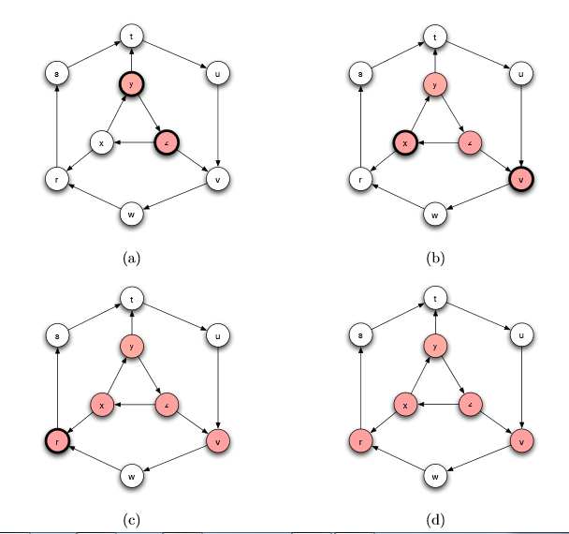
SIR Epidemic Model

Slide 12
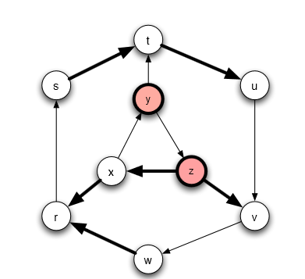
Percolation
The static view of the model
We decide in advance which edges will transmit infection
A node v will become infected during the epidemic if and only if there is a path to v from one of the initially infected nodes that consists entirely of open edges

Slide 13
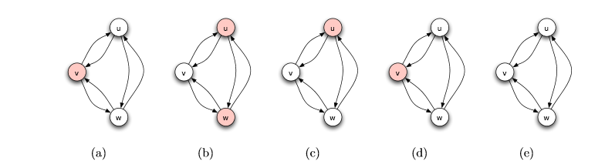
SIS Epidemic Model
There is no Removed state
After a node is done with the Infectious state, it cycles back to the Susceptible state and is ready to catch the disease again
Initially, some nodes are in the I state and all others are in the S state.
Each node v that enters the state remains infectious for a fixed number of steps t_{I}
During each of these t_{I} steps, v has a probability p of passing the disease to each of its susceptible neighbors.
After t_{I} steps, node v is no longer infectious and it returns to the S state

Slide 14
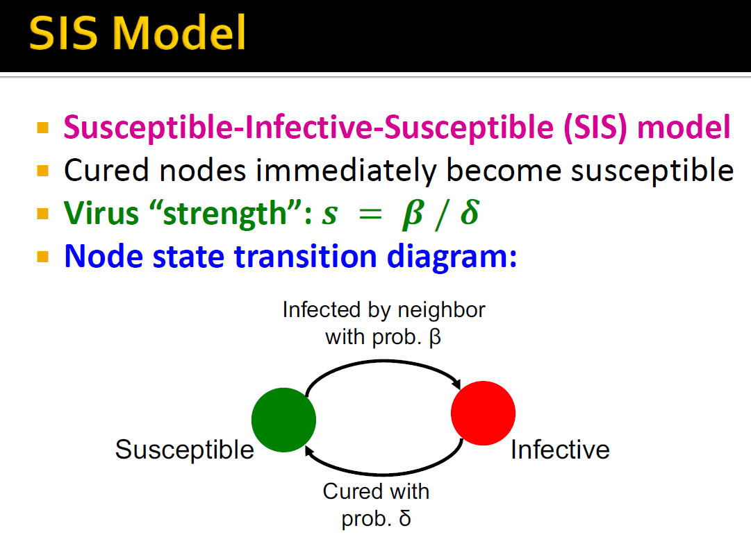

Slide 15
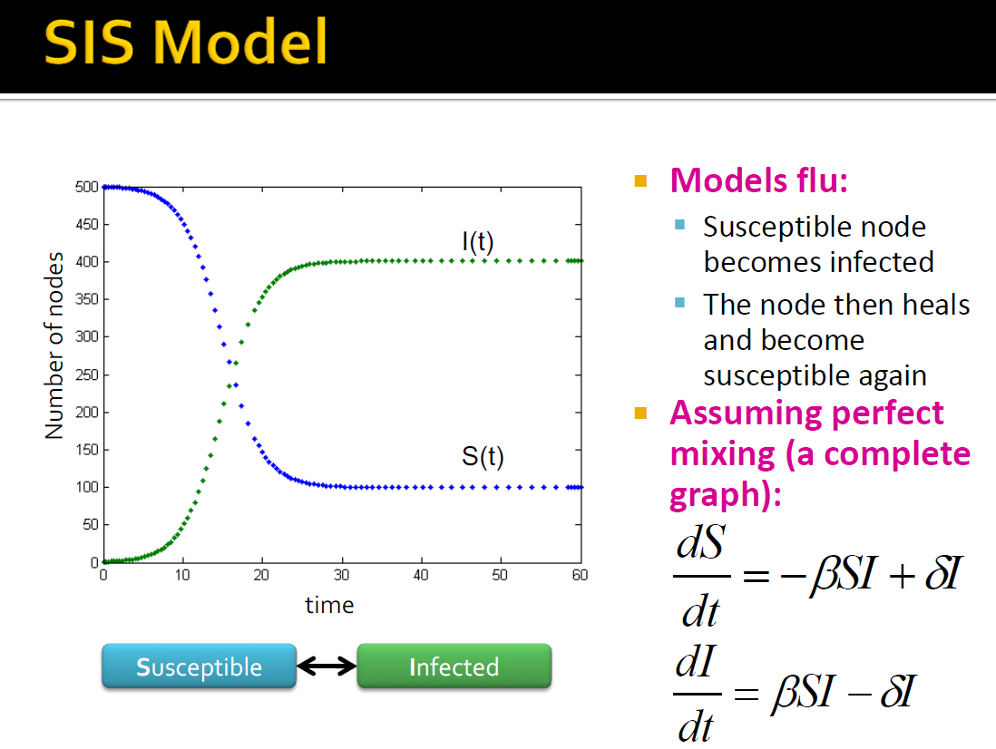

Slide 16
SIR vs SIS
In a SIR epidemic graph the nodes decrease over time – so the epidemic will ultimately die down after a relatively small number of steps
A SIS epidemic can run for an extremely long time
At at a particular critical value of the contagion probability p, SIS epidemic on the network will undergo a rapid shift from one that dies out quickly to one that persists for a very long time
SIS model can be converted to SIR model by a time-expanded contact network
A new copy of each infected node is created

Slide 17
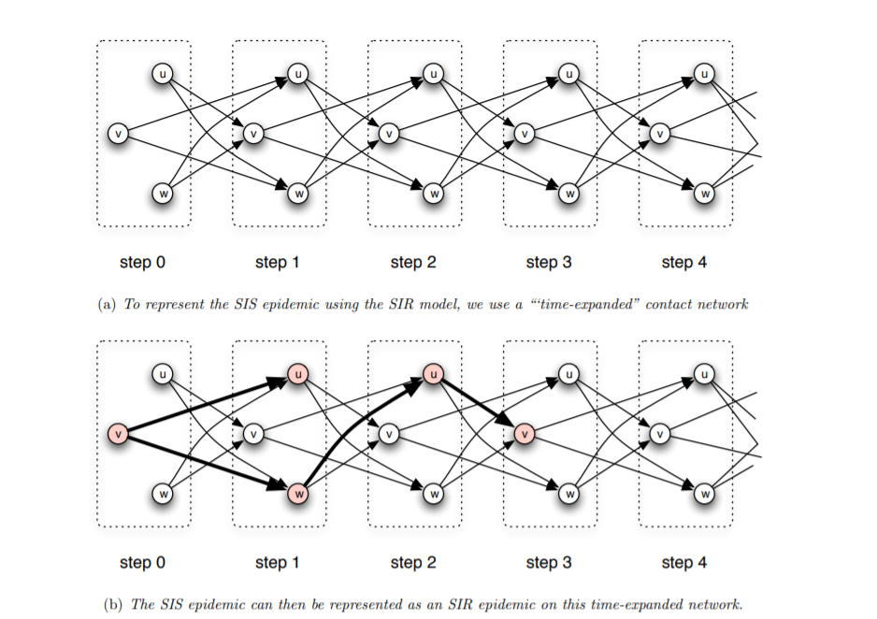
Time-expanded contact network
We think about a node v as in fact being a “different individual” at each time step, then we can represent things so that nodes are never reinfected.
We create a separate copy of each node for each time step t = 0, 1, 2, 3 and onward.
Now, for each edge in the original contact network, linking a node v to a node w, we create edges in the time-expanded contact network from the copy of v at time t to the copy of w at time t + 1

Slide 18
SIRS Epidemic Model
After an infected node recovers, it passes briefly through the R state on its way back to the S state
Initially, some nodes are in the I state and all others are in the S state.
Each node v that enters the state remains infectious for a fixed number of steps t_{I}
During each of these t_{I} steps, v has a probability p of passing the disease to each of its susceptible neighbors.
After t_{I} steps node v is no longer infectious. It then enters the R state for a fixed number of steps t_{R}. During this time, it cannot be infected with the disease, nor does it transmit the disease to other nodes.
After t_{R} steps in the R state, node v returns to the S state

Slide 19
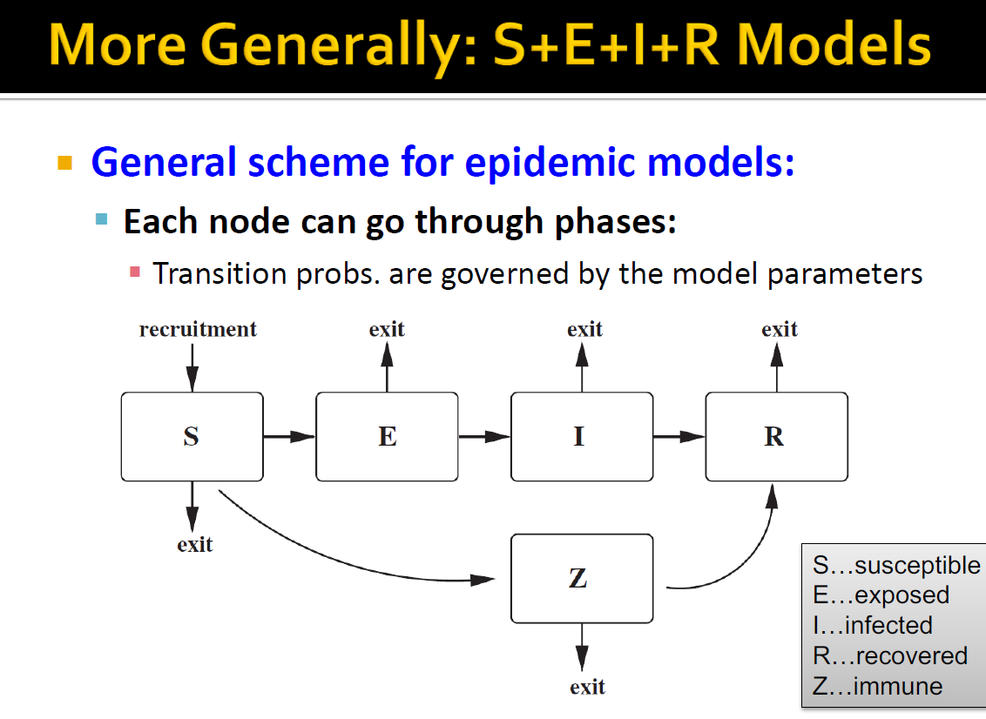

Slide 20
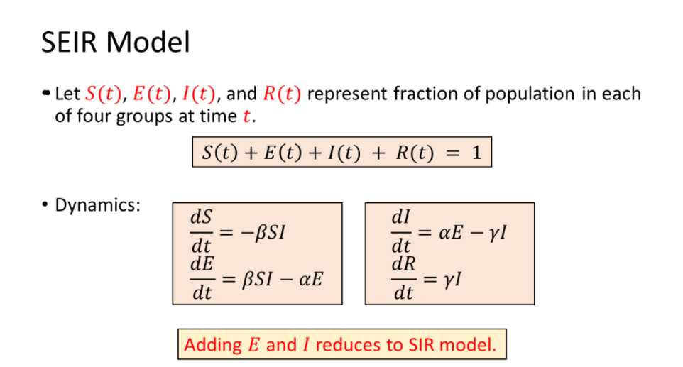

Slide 21
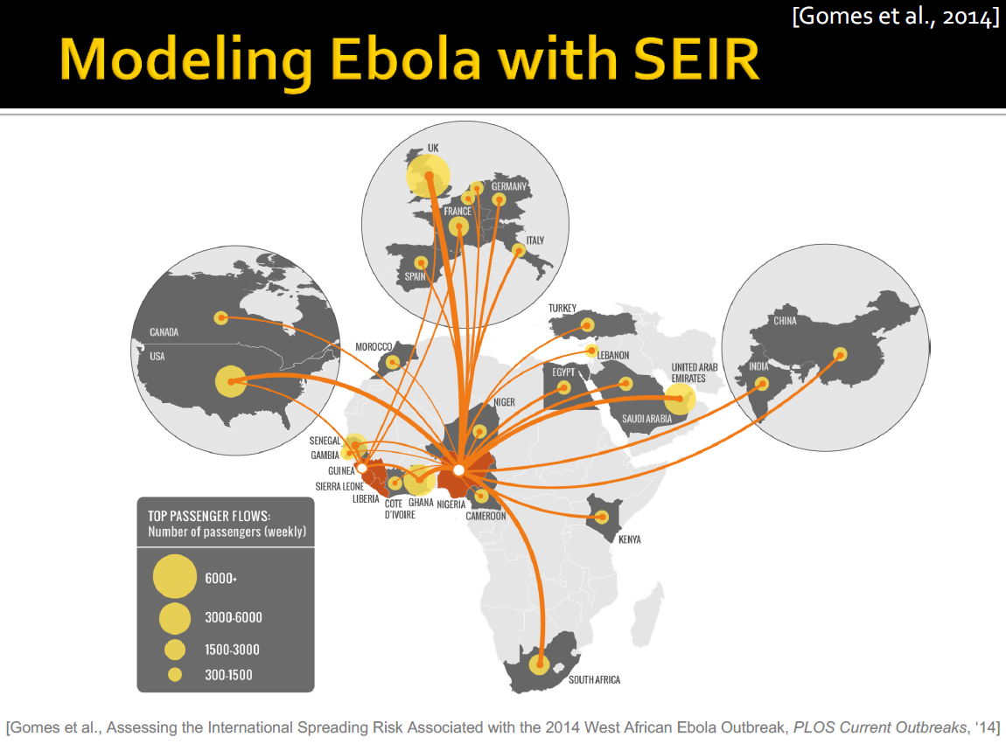

Slide 22
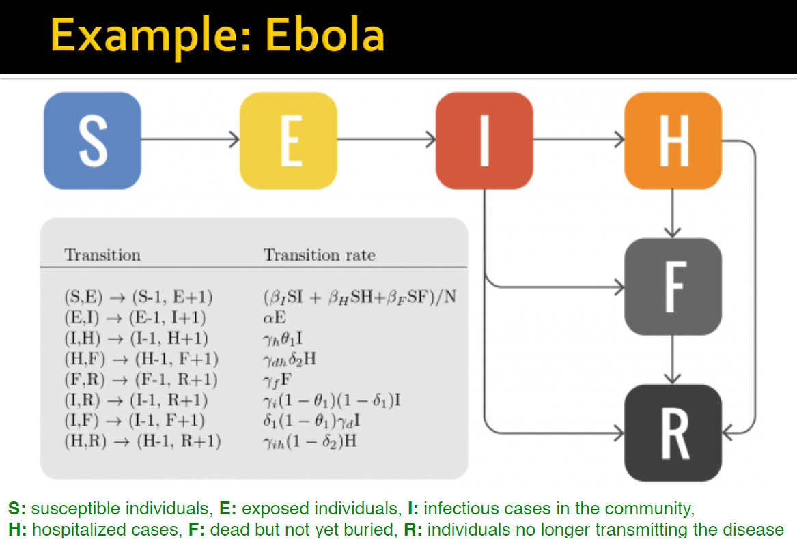

Slide 23
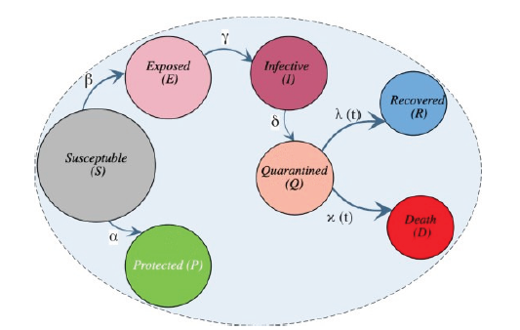
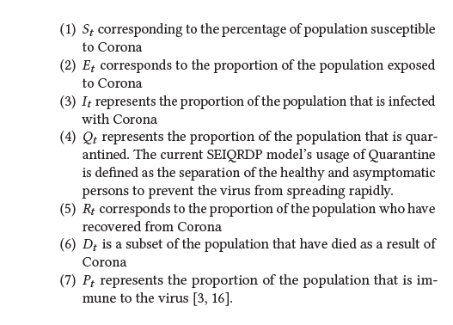
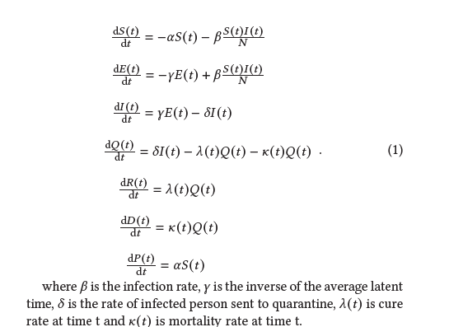
SEIQRDP model

Slide 24
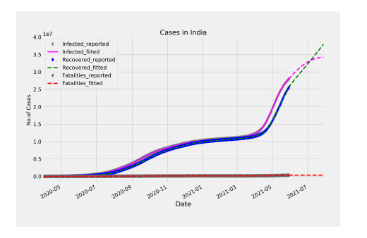
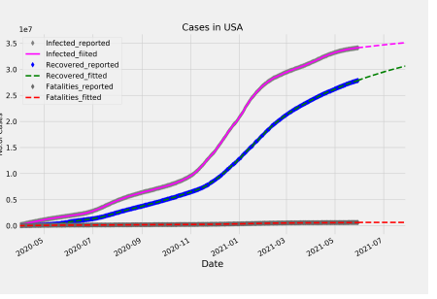
Covid 19 Prediction using SEIQRDP model
Siva Prasad Reddy – Masters Project, IIT Delhi 2021

Slide 25
Oscillations
The tendency of epidemics for certain diseases to synchronize across a population, sometimes producing strong oscillations in the number of affected individuals over time.
Such effects are well-known for diseases including measles and syphilis.
Main requirements:
Long-range link: Produce coordination in the timing of flare-ups across dispersed parts of the network
Temporary immunity: The temporary immunity produces a network-wide deficit in the number and connectivity of susceptible individuals, yielding a large “trough” in the size of the outbreak that directly follows the “peak” from the earlier flare-ups

Slide 26
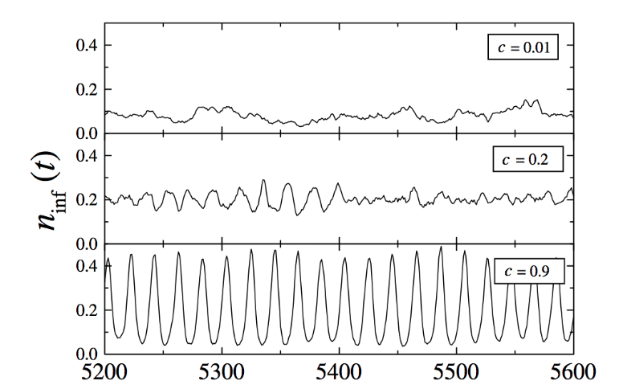
Synchronization
c: Fraction on long range links
Absence of oscillations for small c (c = 0.01)
Wide oscillations for large c (c = 0.9)
A transitional region (c = 0.2) where oscillations intermittently appear and then disappear

Slide 27
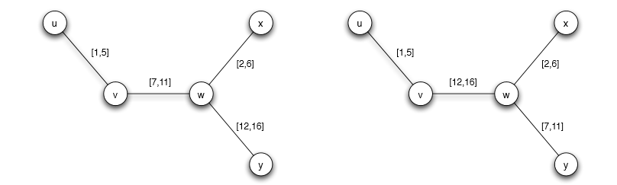
Transient and Concurrent Contacts
The disease can potentially pass
all the way from u to y
The disease can’t potentially pass from u to y

Slide 28
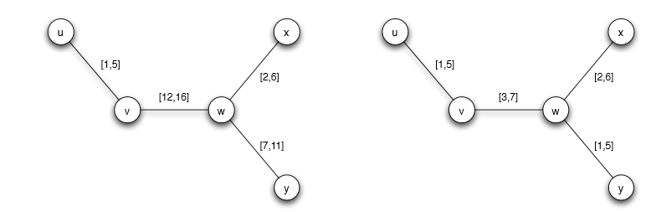
Transient and Concurrent Contacts
Relations are not concurrent
Relations are concurrent
In larger networks, the effects of concurrency on disease spreading can become particularly pronounced

Slide 29
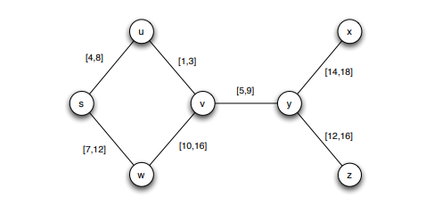
Exercise
Suppose you are studying the spread of a rare disease among the set of people pictured in Figure above. The contacts among these people are as depicted in the network in the figure, with a time interval on each edge showing when the period of contact occurred. We assume that the period of observation runs from time 0 to time 20.
Suppose that s is the only individual who had the disease at time 0. Which nodes could potentially have acquired the disease by the end of the observation period, at time 20?
Suppose that you find, in fact, that all nodes have the disease at time 20. You’re fairly certain that the disease couldn’t have been introduced into this group from other sources, and so you suspect instead that a value you’re using as the start or end of one of the time intervals is incorrect. Can you find a single number, designating the start or end of one of the time intervals, that you could change so that in the resulting network, it’s possible for the disease to have flowed from s to every other node?

Slide 30
Mitochondral Eve
Epidemics model can be used to model other things that spread through a network
Genetic Inheritance
Rebecca Cann, Mark Stoneking, and Allan Wilson Nature (1987)
Following our maternal ancestry
Maternal lineage
Meet at a single woman who lived between 100,000 and 200,000 years ago, probably in Africa
Study based on mitochondrial DNA which is (to a first approximation) passed to children entirely from their mothers

Slide 31
References
Networks, Crowds, and Markets: Reasoning About a Highly Connected World https://www.cs.cornell.edu/home/kleinber/networks-book/
Chapter 21.1-21.7
Mohamed A. Bahloul, Abderrazak Chahid, and Taous-Meriem Laleg-Kirati. 2020. Fractional-Order SEIQRDP Model for Simulating the Dynamics of COVID-19 Epidemic. IEEE Open Journal of Engineering in Medicine and Biology 1 (2020), 249–256. https://doi.org/10.1109/OJEMB.2020.3019758

